Slide 1
Update on Vasodilation project
8/17/2022

Slide 2
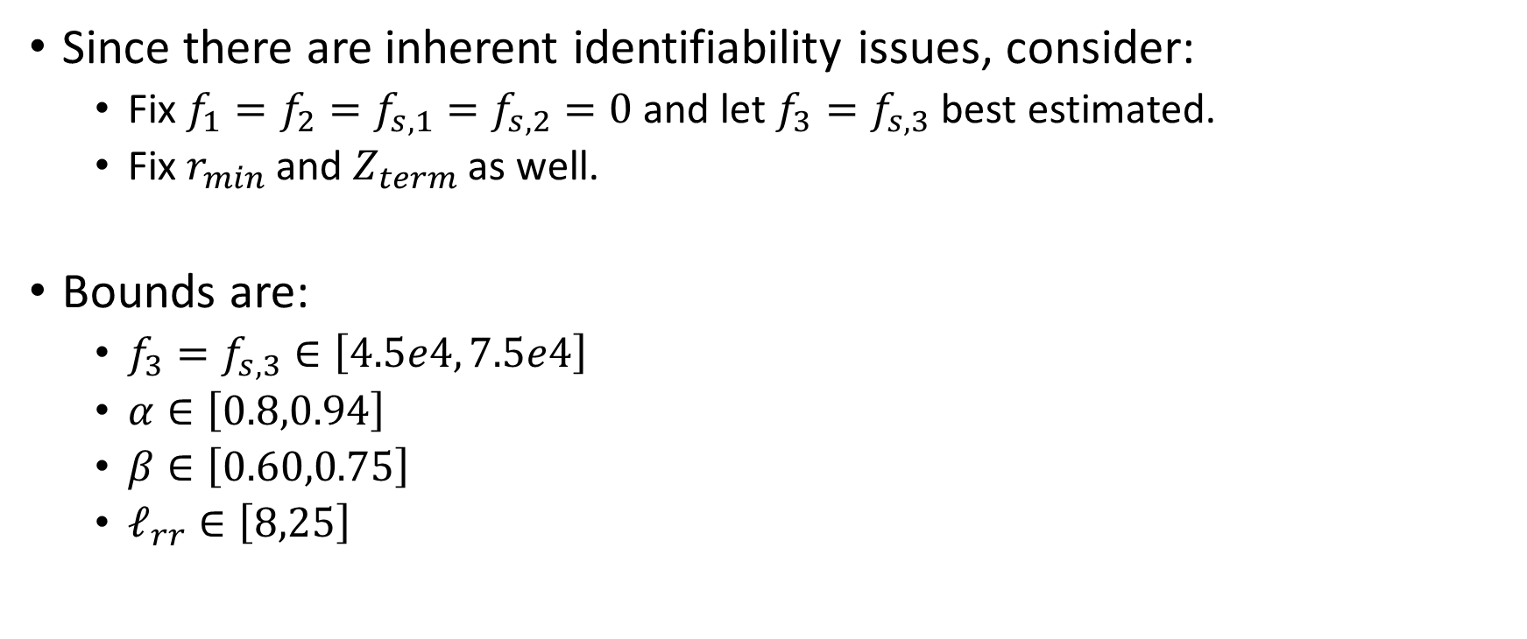
Summary
Since there are inherent identifiability issues, consider:
  Fix $f_{1}=f_{2}=f_{s,1}=f_{s,2}=0$ and let $f_{3}=f_{s,3}$ best estimated.
  Fix $r_{min}$ and $Z_{term}$ as well.
Bounds are:
  $f_{3}=f_{s,3}∈\left[4.5e4, 7.5e4\right]$
  $α∈\left[0.8,0.94\right]$
  $β∈\left[0.60,0.75\right]$
  $ℓ_{rr}∈\left[8,25\right]$

Slide 3
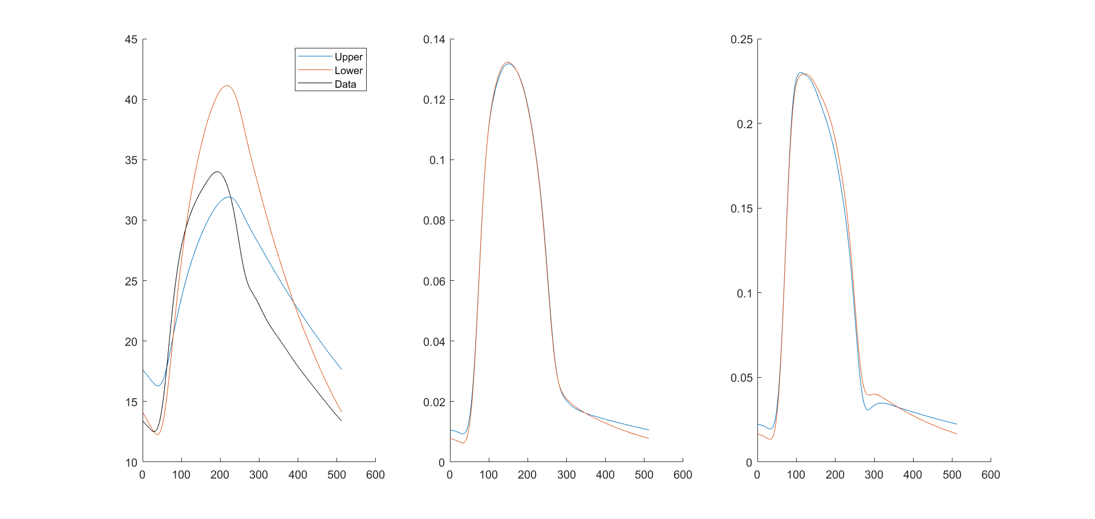

Changing $f_{3}=f_{s,3}$

Slide 4
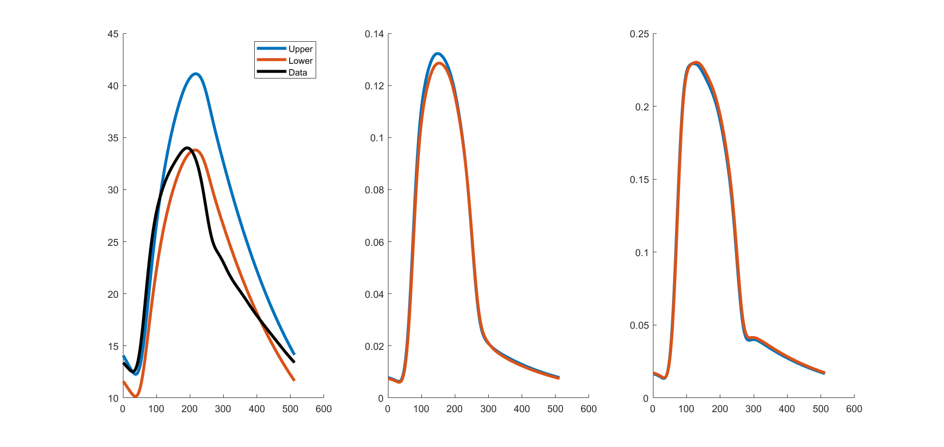
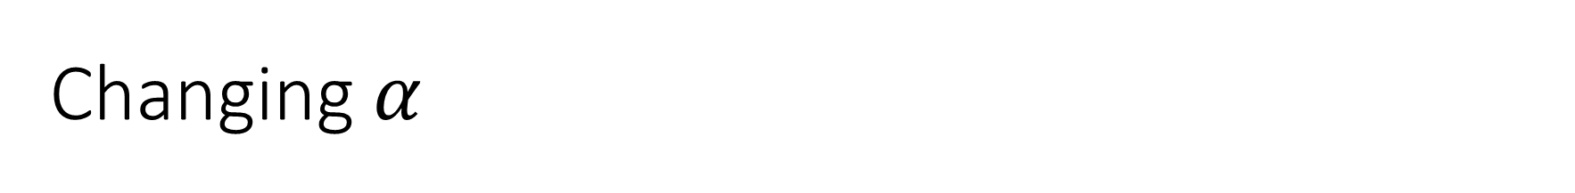
Changing $α$

Slide 5
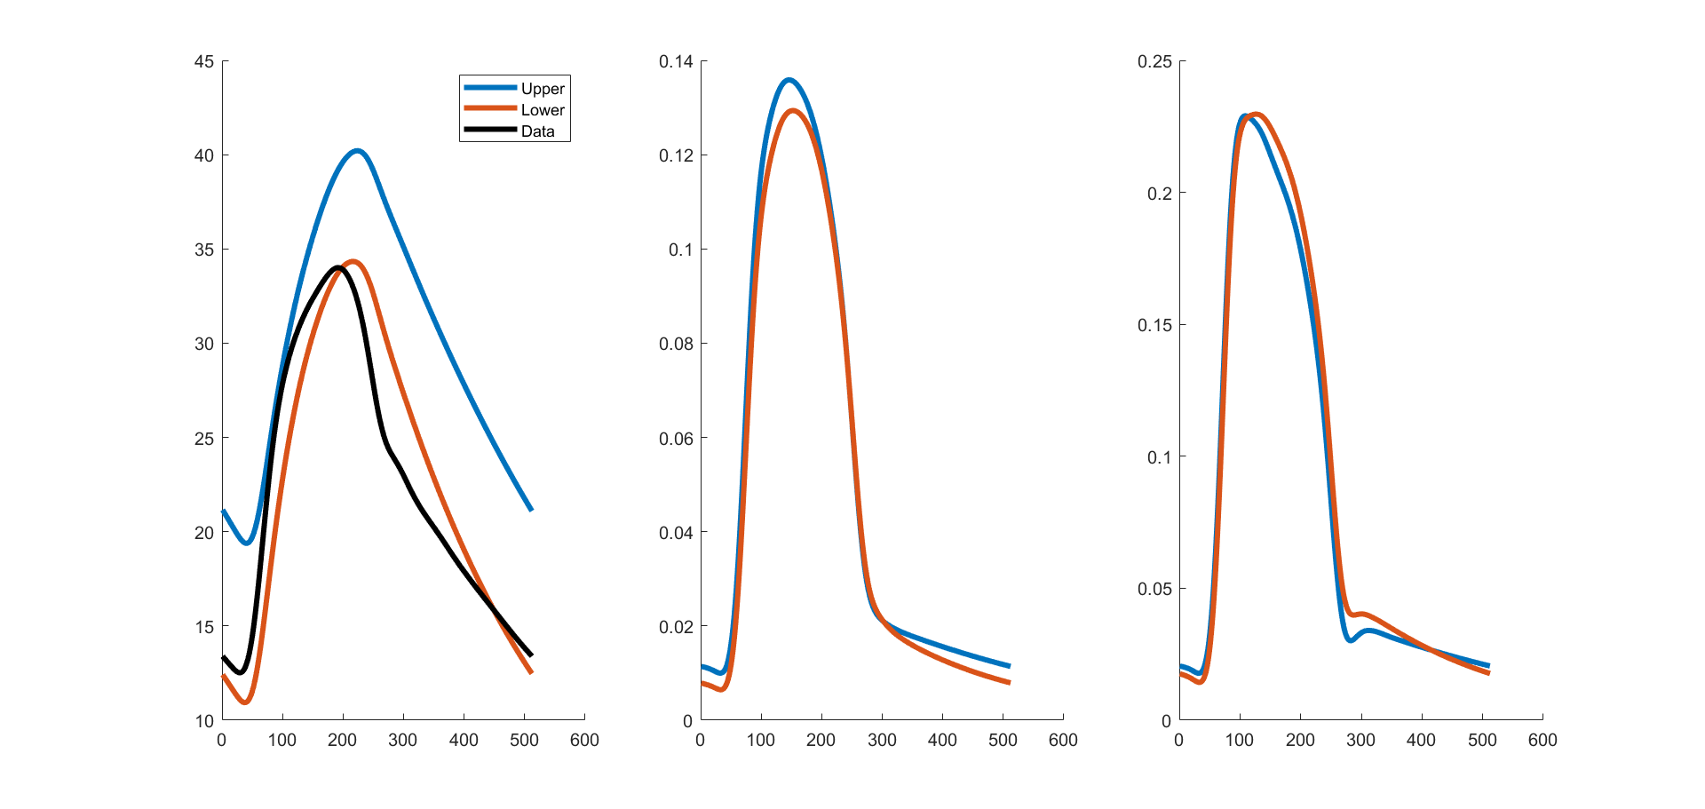
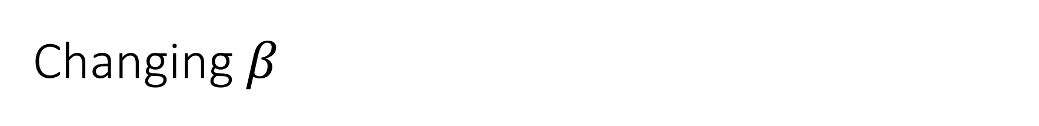
Changing $β$

Slide 6
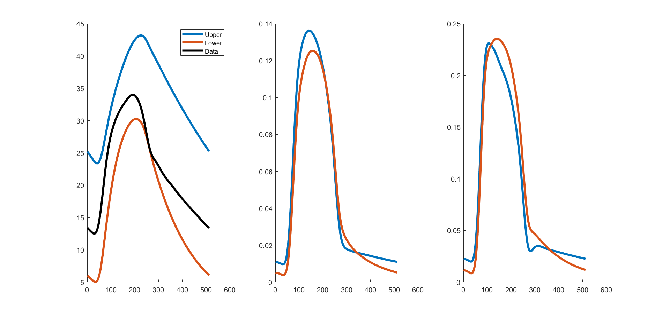
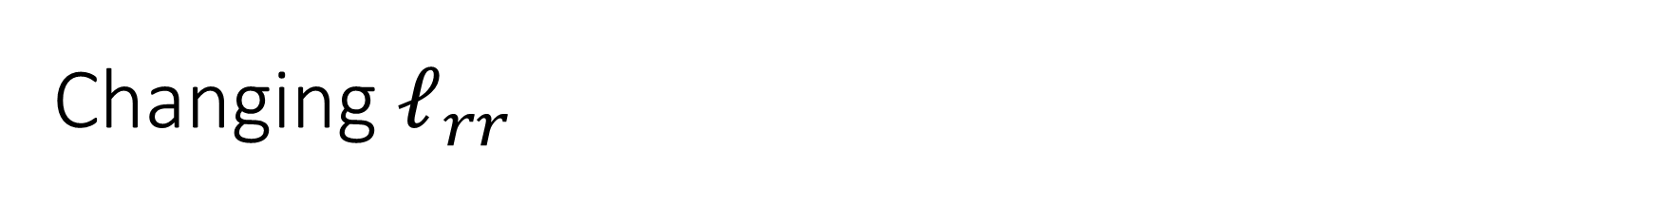
Changing $ℓ_{rr}$

Slide 7
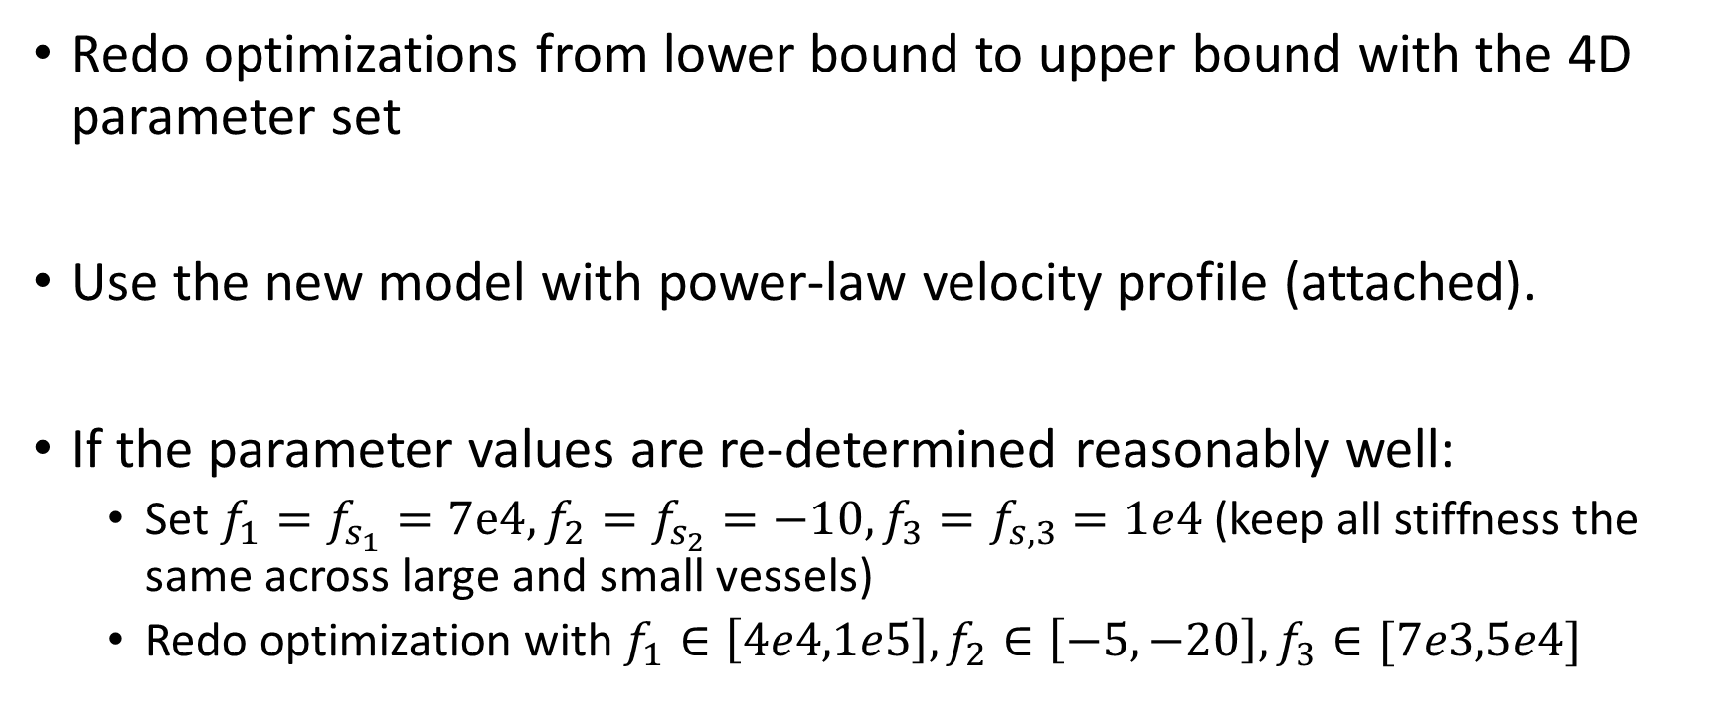
To-do (from Mitchel)
Redo optimizations from lower bound to upper bound with the 4D parameter set
Use the new model with power-law velocity profile (attached).
If the parameter values are re-determined reasonably well:
  Set $f_{1}=f_{s_{1}}=7e4, f_{2}=f_{s_{2}}=−10, f_{3}=f_{s,3}=1e4$ (keep all stiffness the same across large and small vessels)
  Redo optimization with $f_{1}∈\left[4e4,1e5\right], f_{2}∈\left[−5,−20\right],f_{3}∈[7e3,5e4]$

